Slide 1
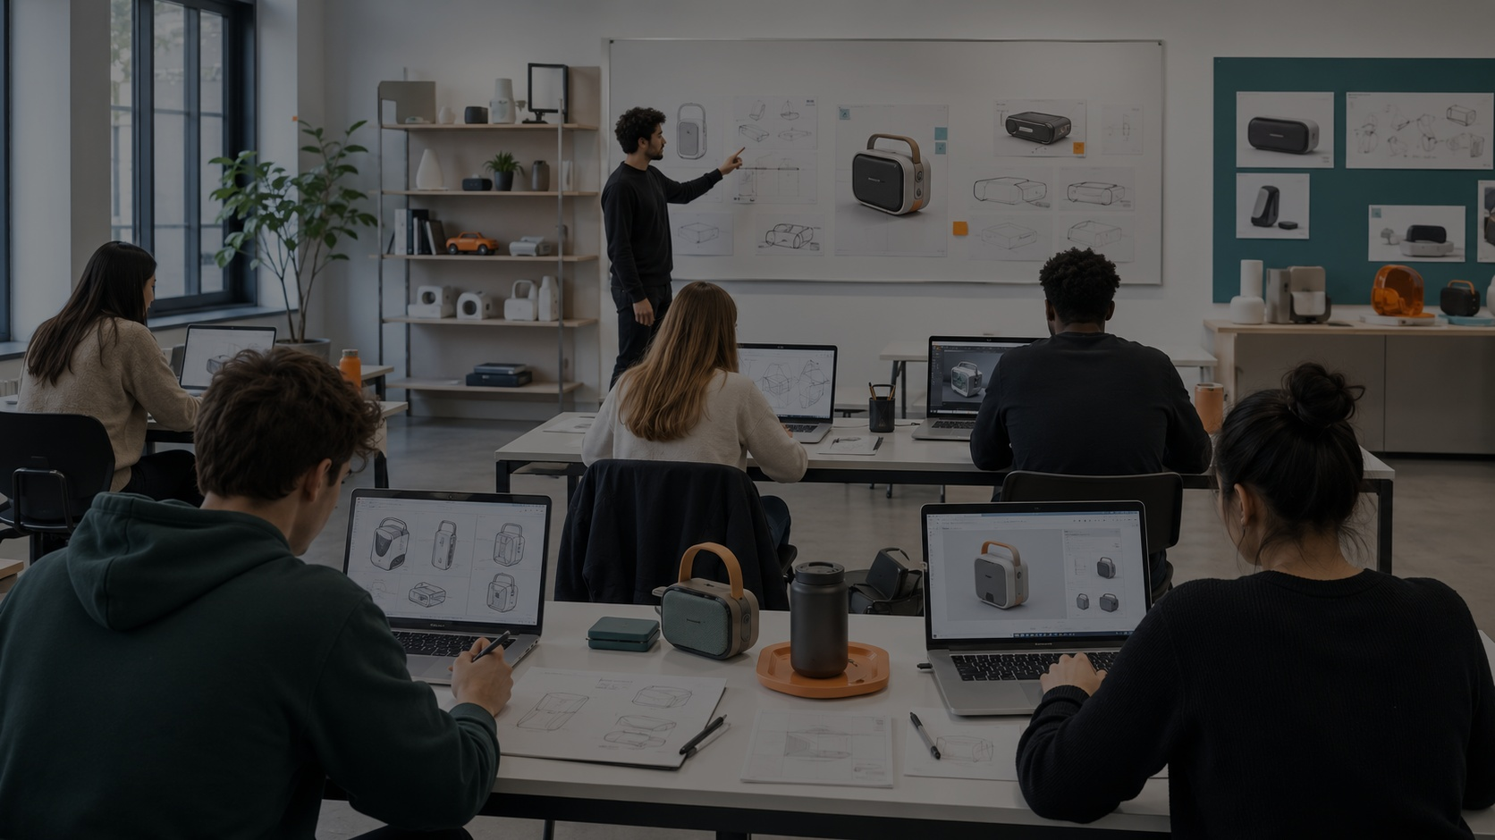
Specification of Products and Services
Session 3 — Materials, CMF & Productive Direction
From requirements to material decisions, finishes, production logic and evidence.
Robust Design Sprint
01

Slide 2
Session 3
Where Session 3 fits
Session 2 defined what the product must achieve. Session 3 starts defining what it could be made of, how it feels, and how it may be produced.
2
3
4
5
Session 2
Session 3
Session 4
Session 5
Concept & Requirements
Materials + CMF
Drawings + BOM
Ergonomics + MVP
What must it do?
What is it made of?
What parts define it?
How will it be tested?
02

Slide 3
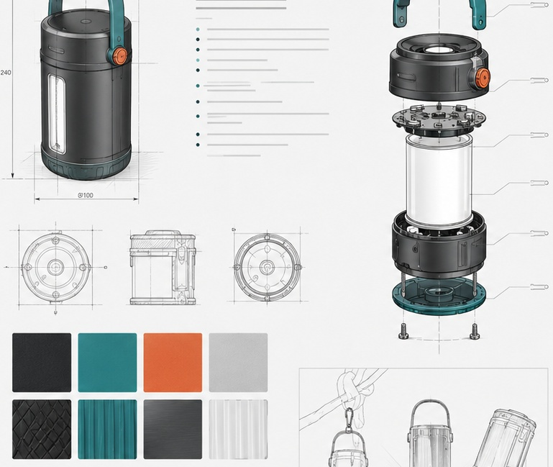
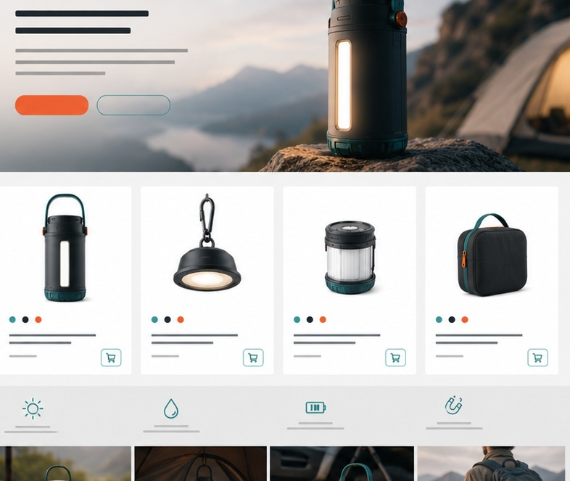
Session 3
Today’s goal
Same product, two languages.
Technical report: material logic for a manufacturer
Visual/commercial report: material story for the user
03

Slide 4
Session 3
What we will define today
1. Material strategy
2. CMF direction
3. Production direction
Which materials make sense for use, resistance, comfort, cleaning, cost and production?
What colors, materials and finishes support the product identity and user experience?
Which processes could manufacture the main parts: sewing, injection, CNC, 3D printing, RF welding, etc.?
4. Material risks
5. Alternatives
6. Evidence needed
What could fail: scratches, tears, leaks, weight, high cost, cleaning, water damage or weak joints?
What backup materials or processes could work if the first option is not viable?
What photos, tests, references, samples, diagrams or comparisons will support the decision?
Deliverable: Materials, CMF and Productive Direction Report
04

Slide 5
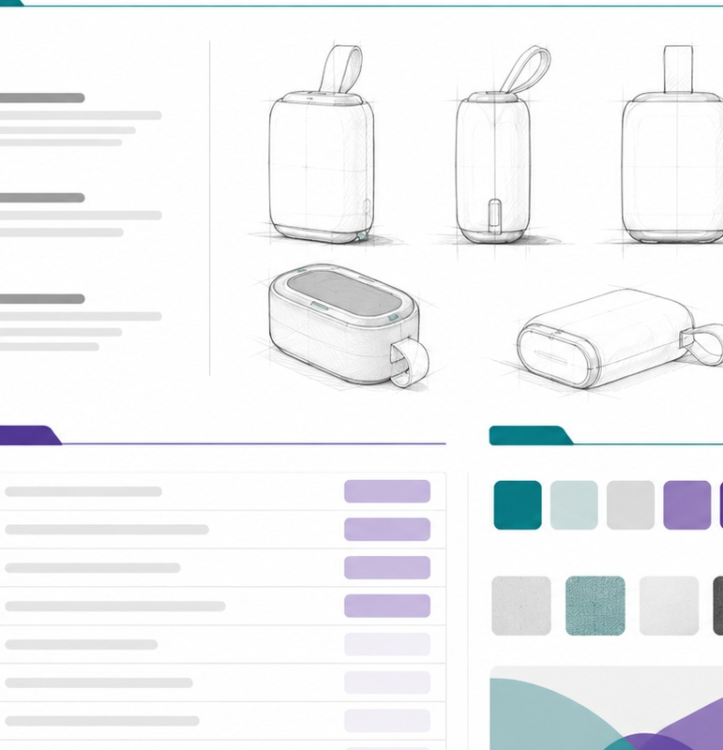
Session 3
How to choose materials
Use context
Water, movement, impact, friction, weight, cleaning, heat, outdoor use.
User body
Grip, touch, comfort, pressure, sweat, posture, adjustability.
Production
How it can be cut, sewn, molded, printed, welded, assembled.
Business
Cost, suppliers, availability, repair, replacement parts.
Communication
What the material says: durable, premium, light, safe, sustainable.
05

Slide 6
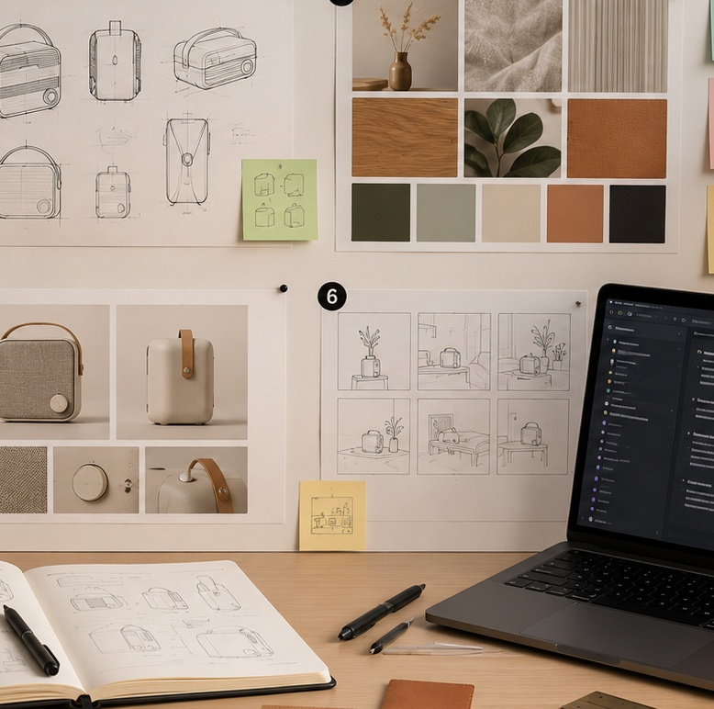
Session 3
CMF is not decoration
CMF = Color + Material + Finish
It connects technical performance with product identity.
Color
Visibility, identity, safety, emotion, product family.
Material
Durability, comfort, weight, cleaning, sustainability.
Finish
Texture, grip, perceived quality, maintenance, scratches.
Example: “textured matte finish” can mean grip + durability + sport identity.
06

Slide 7
Session 3
Session 3 deliverable checklist
Materials, CMF and Productive Direction Report
1. Cover / Header
Project name, team, course, session and main product image.
6. Production process direction
Possible processes for each major part or component.
2. Material strategy
General explanation of the material needs of the product.
7. Risks and alternatives
What could fail and what backup options exist.
3. Materials table
Part, material, properties, process, finish, justification and risk.
8. Technical explanation
How this should appear in the report for a manufacturer.
4. CMF palette
Colors, materials, textures and finishes with short captions.
9. Visual/commercial explanation
How materials will be shown to the final user.
5. Material references
Photos, samples, benchmarks, suppliers or real material examples.
10. Next steps
What to test, measure, draw, quote or confirm before Session 4.
Suggested length: 8–12 pages. Visual, concise, with tables, captions and clear evidence.
07

Slide 8
Session 3
Main table for Session 3
This table turns your Session 2 requirements into material and production decisions.
Part / Component
Proposed Material
Key Properties
Process
Finish / Color
Risk / Alternative
Main body
to be defined
durable, light, safe
injection / sewing / RF welding
matte / textured
needs testing
Strap / support
to be defined
flexible, strong, comfortable
cutting + sewing
textile finish
check resistance
Connector / joint
to be defined
precise, repeatable, strong
injection / CNC / commercial
neutral / technical
check tolerance
User touch area
to be defined
soft, washable, ergonomic
foam / textile / rubber
grip texture
check cleaning
Replaceable module
to be defined
modular, easy to remove
assembly / fastener
brand color
check wear
Add images next to the table: material reference, component sketch, prototype photo or production example.
Do not claim “final material” unless you have evidence. Use “proposed material” or “to be tested”.
08

Slide 9
Session 3
NotebookLM prompt for Session 3
Using the Session 2 Concept and Requirements report, create a material and CMF proposal for this product.
Include:
1. Material strategy
2. Main parts and possible materials
3. Material properties needed
4. Possible production processes
5. CMF palette direction
6. Material risks
7. Alternative materials
8. How to explain the materials in the technical report
9. How to communicate the materials in the visual/commercial report
Do not invent final specifications. If information is missing, write “to be defined” or “needs testing”.
09

Slide 10
Session 3
In-class workflow
Four hours to turn requirements into material and CMF decisions.
0:00–0:35
Review Session 2 requirements
Highlight which requirements affect material, comfort, production and safety.
0:35–1:15
Material research
Find possible materials, properties, risks, suppliers and references.
1:15–2:05
CMF direction
Define color, texture, finish, visual tone and product attributes.
2:05–2:45
Production direction
Map possible processes for each main component.
2:45–3:30
NotebookLM draft
Generate and edit the report draft using the Session 3 prompt.
3:30–4:00
Review + next steps
Prepare missing evidence list and actions for Session 4.
End of class output: first draft + material table + CMF direction + missing evidence list.
10

Slide 11
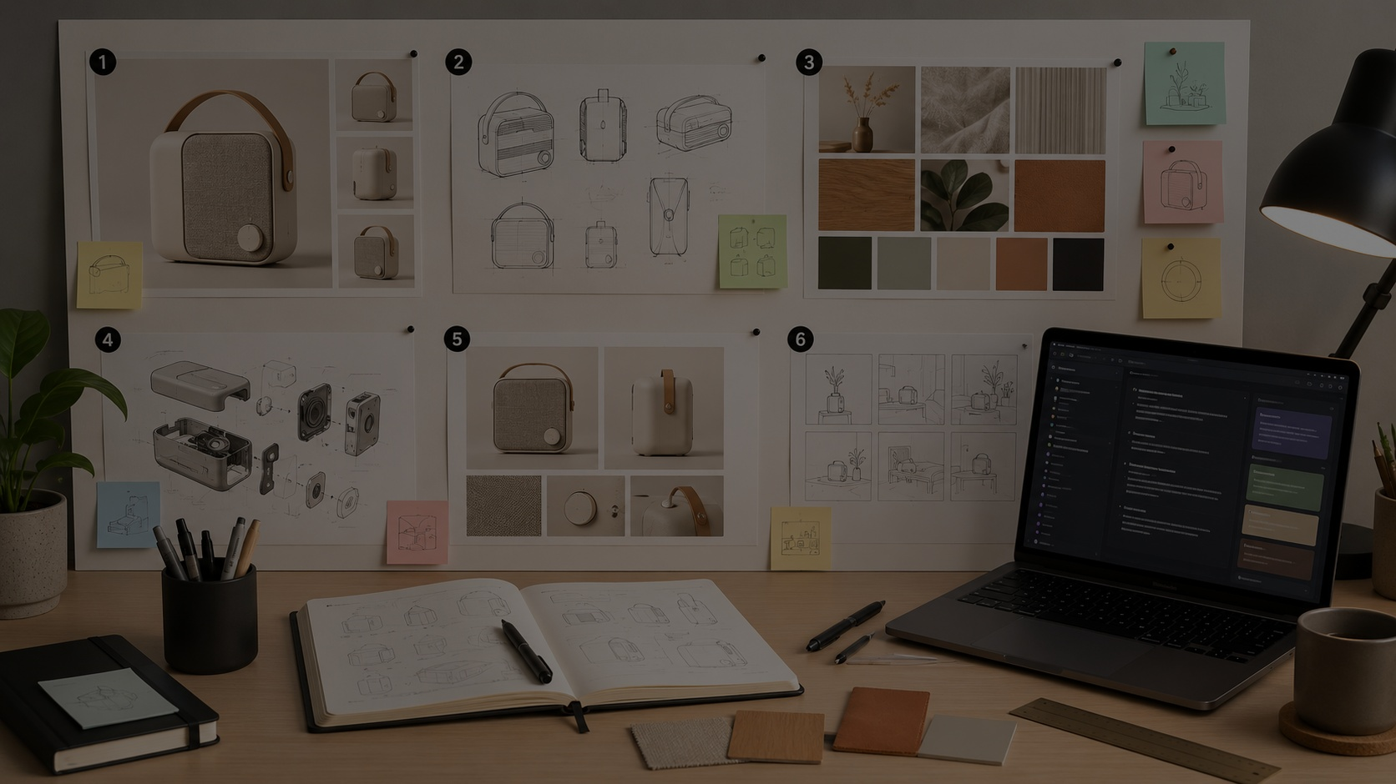
For next time
A proposed material for each main component.
A CMF palette with colors, textures and finishes.
A short explanation for the technical report.
A short explanation for the visual/commercial report.
A list of tests, measurements or images still needed.
Session 4 will use this information to build drawings, exploded views and BOM.
11

